Slide 1

ARTYOM GRISHIN
REMAL GAREEV
VLAD MERKULOV
Russia On Fire
Building a website that contains information about fires in Russia from 2000 to 2024.
RUSSIA ON FIRE

Slide 2
OBJECTIVE
We wanted to investigate the fires in our homeland
It is useful for government services
It visualizes the social problem
The project aims to engage people emotionally and intellectually with the problem of wildfires.
RUSSIA ON FIRE

Slide 3
METHODOLOGY
TIMELINE
FIRES
FEATURES
2000-2024 years
1.459.464 fires
14 features
We have found the dataset with more than a million rows.
The dataset had 23 features in total, but after the EDA only 14 were left
RUSSIA ON FIRE
Reference for dataset: https://tochno.st/datasets/fires (Реестр природных пожаров (1T-ИСДМ))

Slide 4
How do we make a solution that helps government services understand and predict wildfires, and also helps people learn about this problem?
RUSSIA ON FIRE

Slide 5
We builded website
Technologies:
Python
TypeScript React Tailwind
FASTApi
SqlAlchemy
Pydantic
D3
Leaflet
Docker
RUSSIA ON FIRE

Slide 6
KEY FINDINGS
This is what we found through our research.
Finding 1
Forest fires takes only 33% of all fires
Finding 2
The most dangerous regions and years — like Sakha (Yakutia) in 2019–2020 — show how critical it is to monitor and predict fire activity to prevent large-scale environmental damage.
The Sakha (Yakutia) region has the largest hectares of land burned by fires. (2021 year)
Finding 3
Russia had the most fires in 2019 (109 thousands) and 2020 (120 thousands) and 2003 was the most destructive in both terms.
RUSSIA ON FIRE

Slide 7
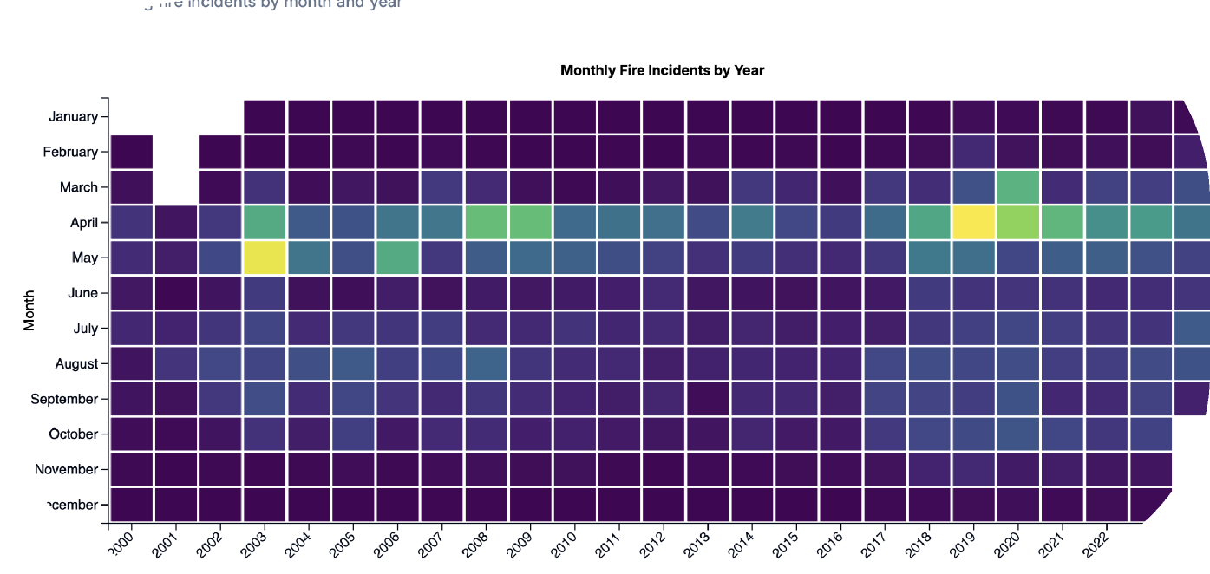
HIGHLIGHTS
Our interesting plot
RUSSIA ON FIRE
The most fire-affected months were May 2003 and April 2019, with 37,411 fires burning 14,139,010 hectares and 38,712 fires burning 4,221,797 hectares, respectively

Slide 8
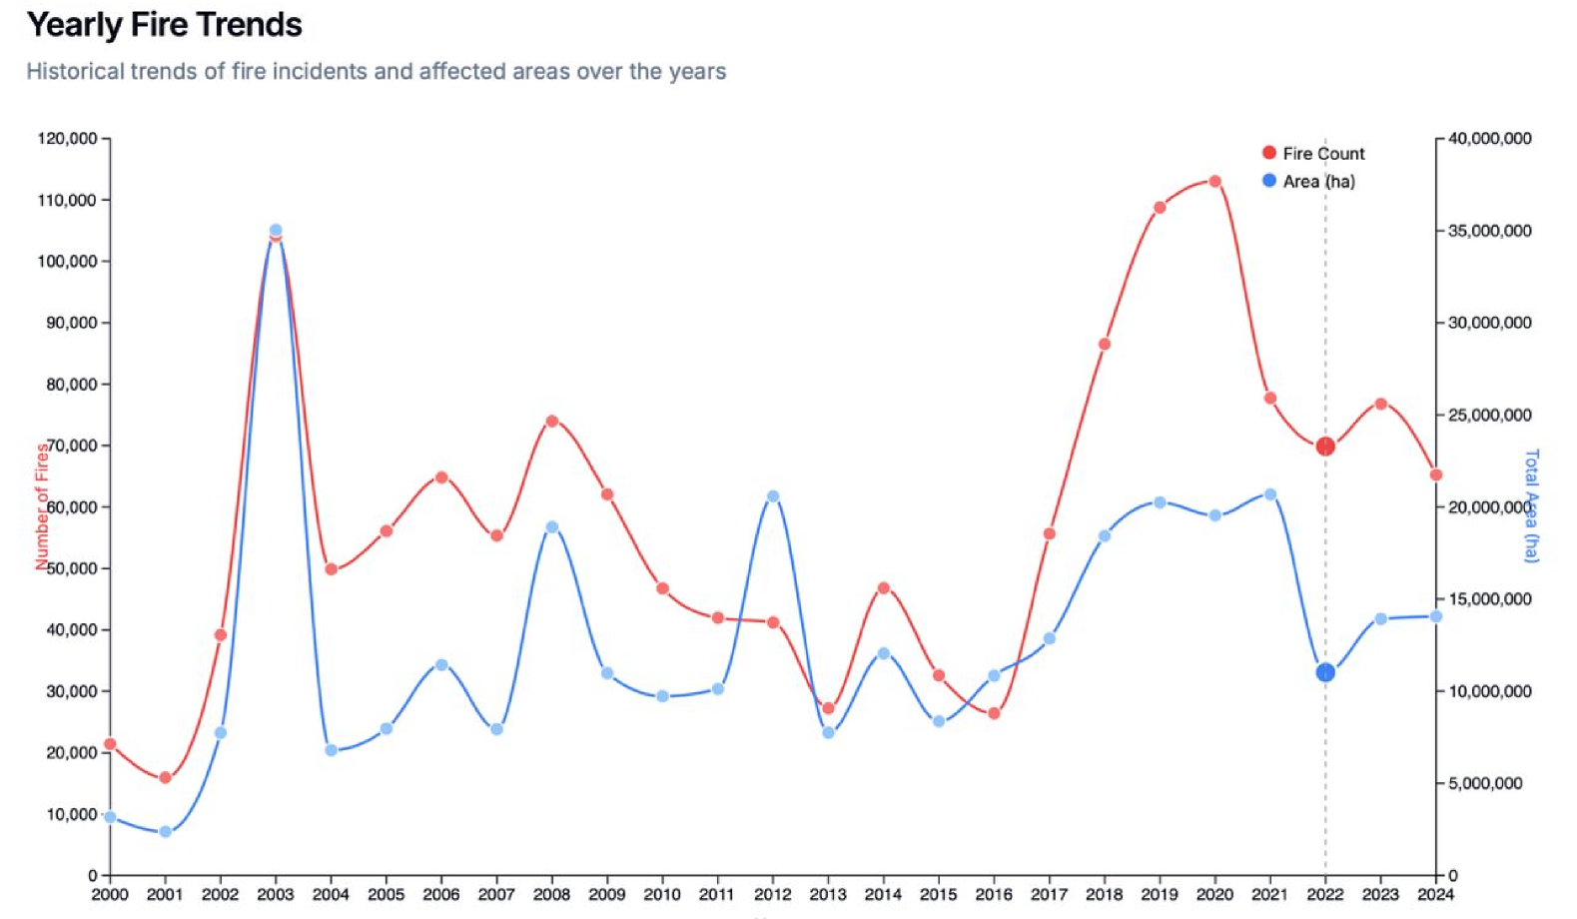
PLOTS
RUSSIA ON FIRE

Slide 9
Finding
Possible Reasons
After analysis we found out that in 24 years the number of fires and the area burned has not decreased or even increased.
Global Warming
Policy enforcement
RUSSIA ON FIRE

Slide 10
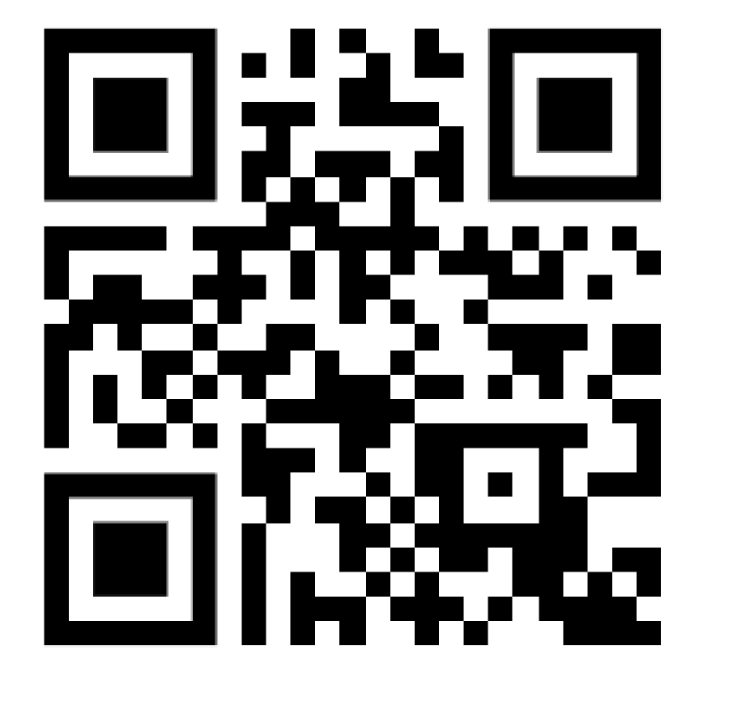
D
E
M
O
RUSSIA ON FIRE

